Slide 1

UNVEILING THE SECRETS OF AIRBNB IN NYC: DATA METHODOLOGY
Nitish kumar

Slide 2
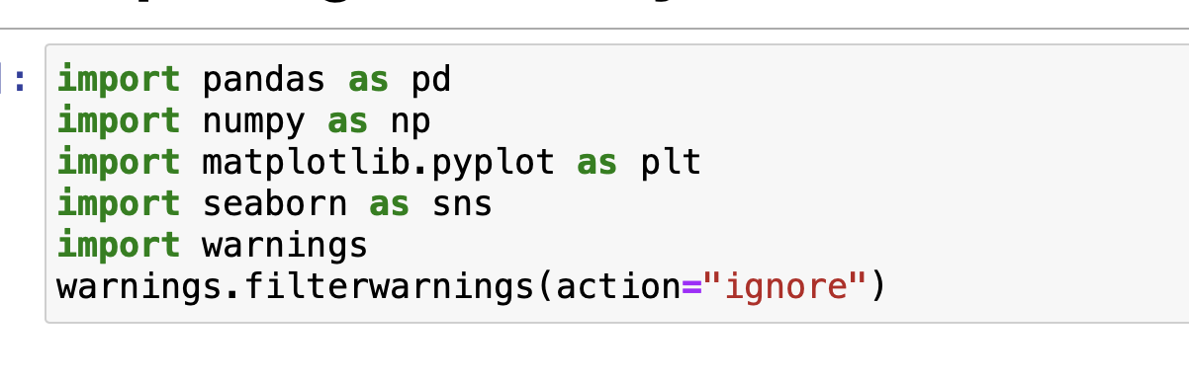
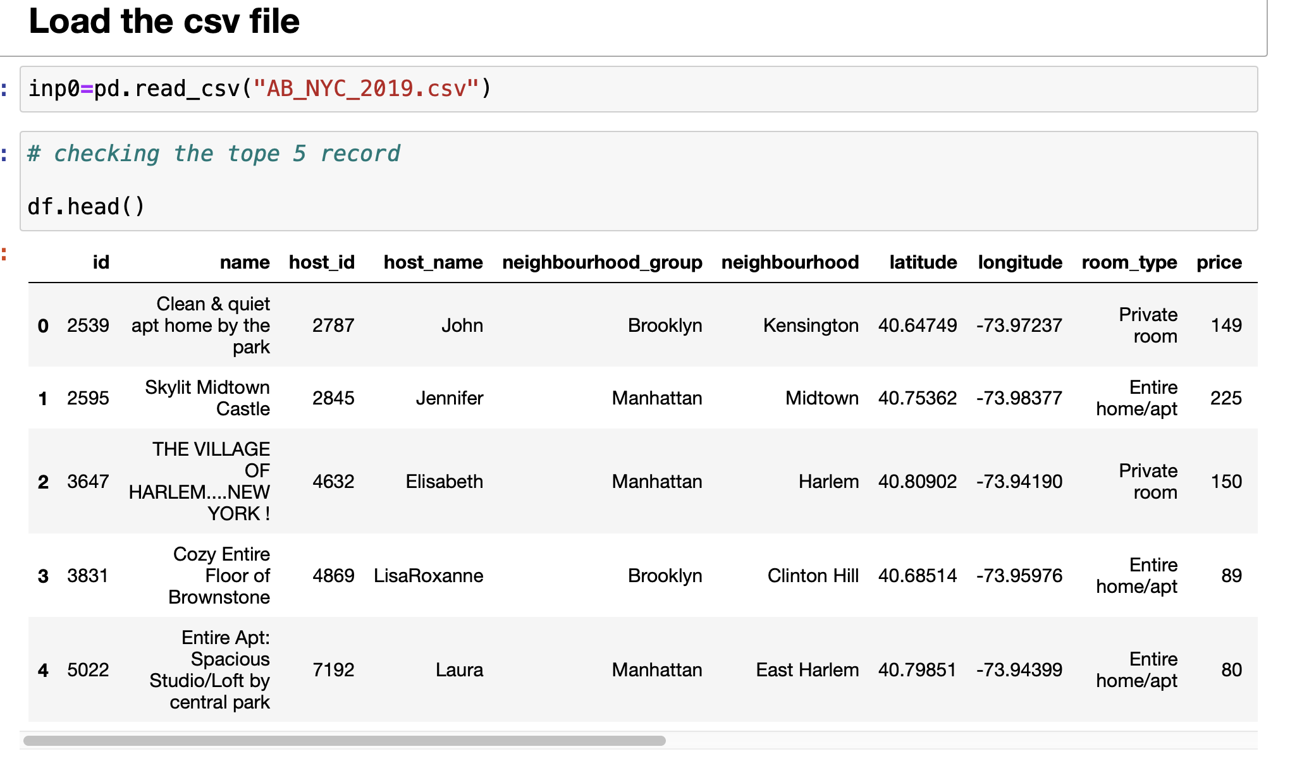
1. Importing libraries and reading the data

Slide 3
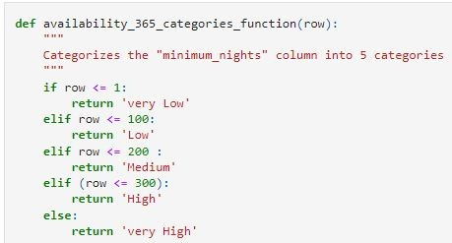
2.1 categorizing the "availability_365" column into 5 categories
2. Creating features

Slide 4
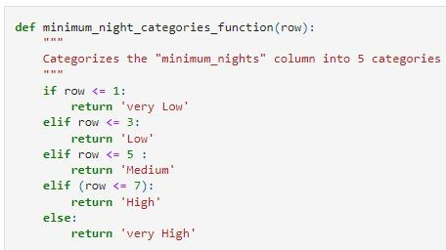
2.2 categorizing the "minimum_nights" column into 5 categories

Slide 5
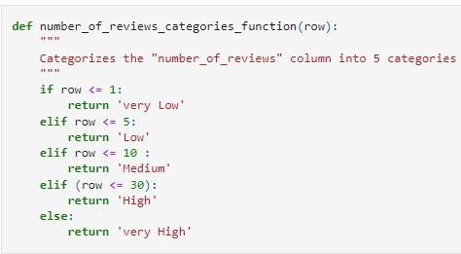
2.3 categorizing the "number_of_reviews" column into 5 categories

Slide 6
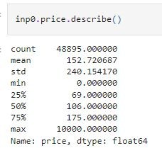
2.4 categorizing the "price" column into 5 categories

Slide 7
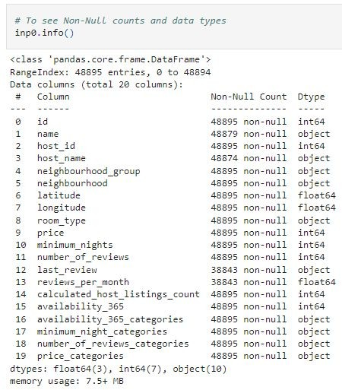
3. Fixing columns

Slide 8
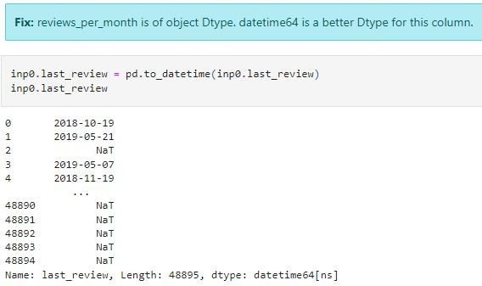

Slide 9
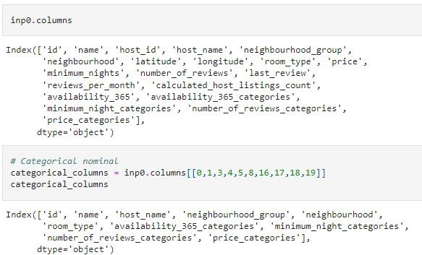
Data types
Categorical

Slide 10
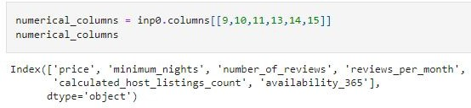
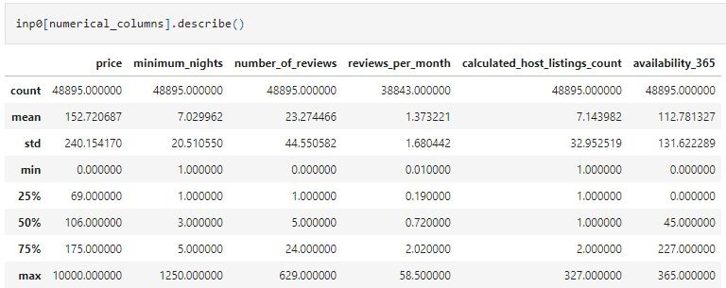
4.2 Numerical

Slide 11
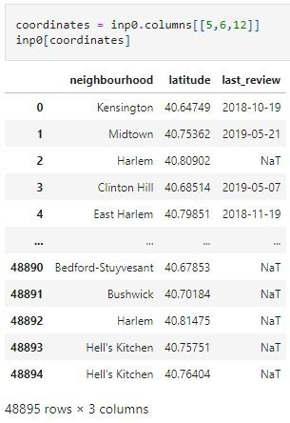
4.3 Coordinates and date

Slide 12
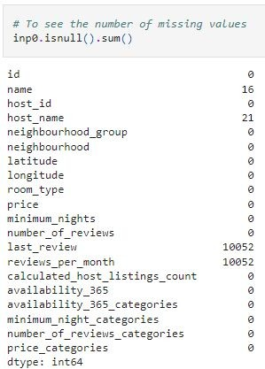
5. Missing values
- Two columns (last_review , reviews_per_month) has around 20.56% missing values. name and host_name has 0.3% and 0.4 % missing values
We need to see if the values are, MCAR: It stands for Missing completely at random.
The reason behind the missing value is not dependent on any other features or if it is MNAR: It stands for Missing not at random. There is a specific reason behind the missing value.
There is no dropping or imputation of columns as we are just analyzing the dataset and not making a model.Also most of the features are important for our analysis.

Slide 13

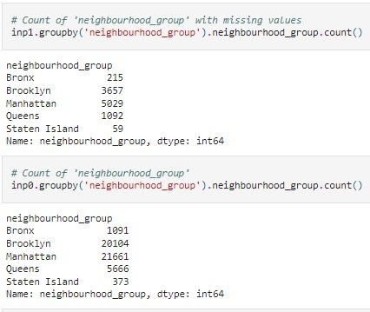
5.2 Missing values Analysis ('neighbourhood_group' feature)
5.1 Missing values Analysis

Slide 14
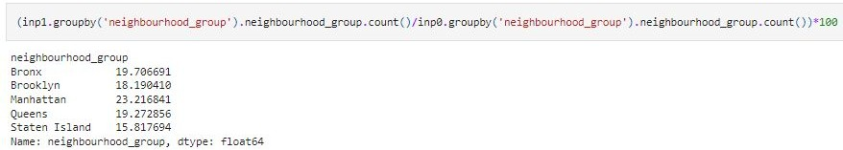
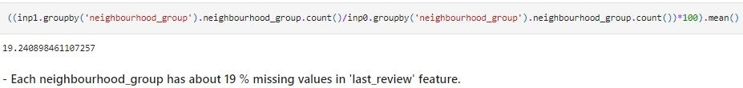

Slide 15
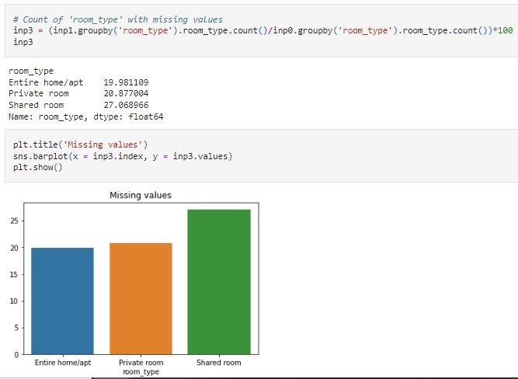
5.3 Missing values Analysis ('room_type' feature)
'Shared room' has the highest missing value percentage (27 %) for 'last_review' feature while to other room types has only about 20 %.

Slide 16
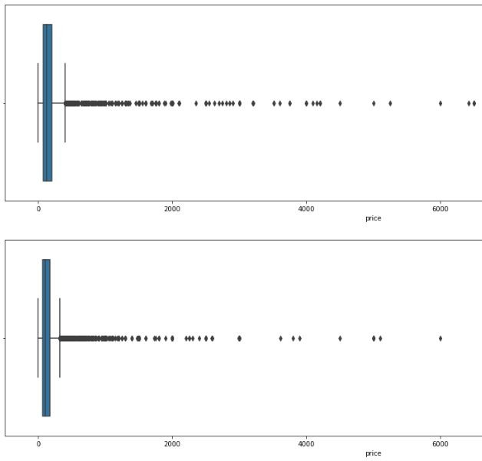
The pricing is higher when 'last_review' feature is missing .
reviews are less likely to be given for shared rooms
When the prices are high reviews are less likely to be given
The above analysis seems to show that the missing values here are not MCAR (missing completely at random)

Slide 17
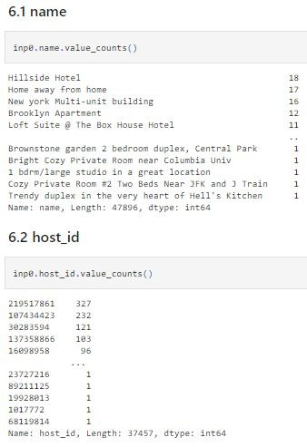
6. Univariate Analysis

Slide 18
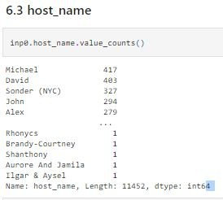

Slide 19
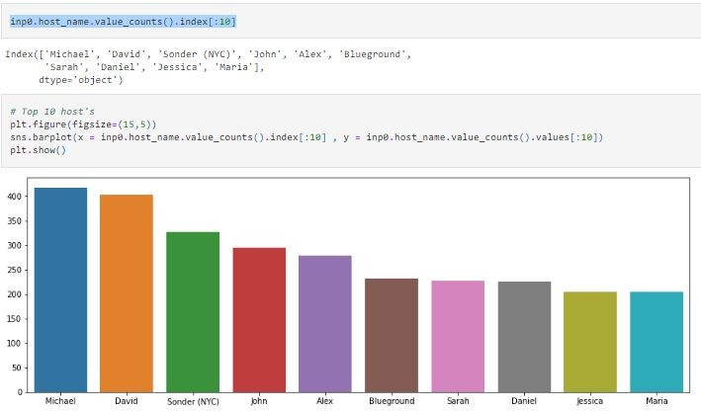

Slide 20
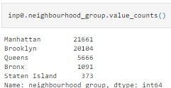
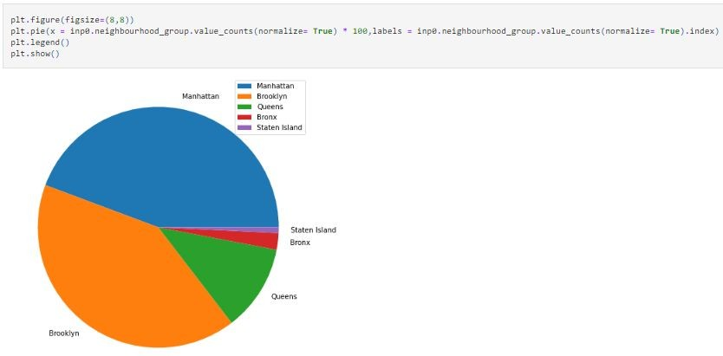
6.4 neighbourhood_group
What are the neighbourhoods they need to target? 81 % of the listing are Manhattan and Brooklyn neighbourhood_group

Slide 21
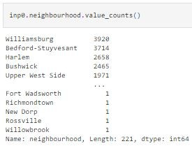
6.5 neighbourhood

Slide 22
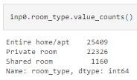
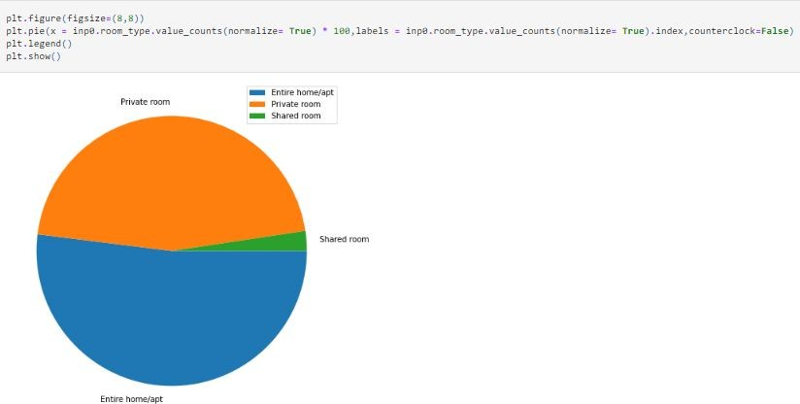
6.6 room_type

Slide 23
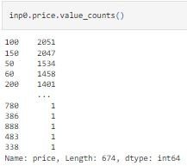
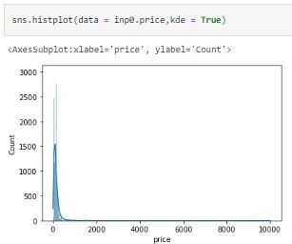
6.7 price

Slide 24
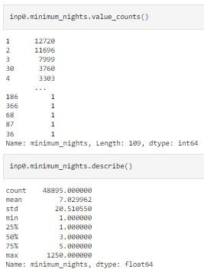
6.8 minimum_nights

Slide 25
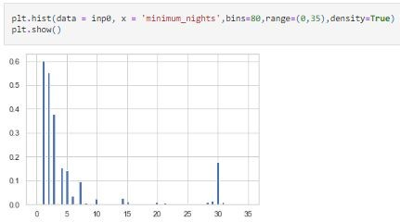

Slide 26
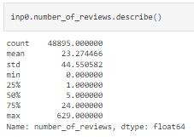
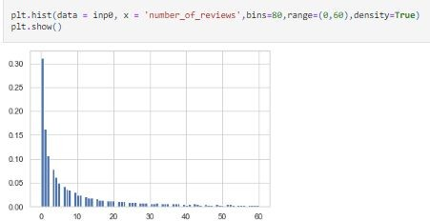
6.9 number_of_reviews

Slide 27
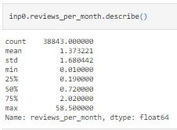
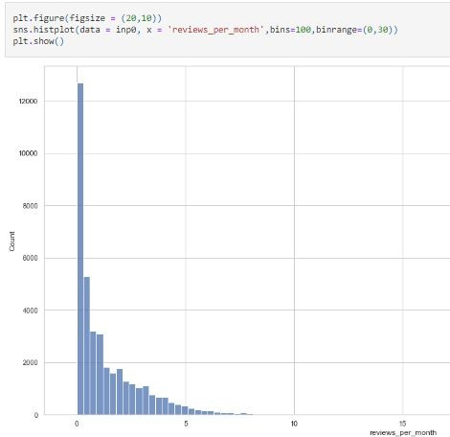
6.10 reviews_per_month

Slide 28
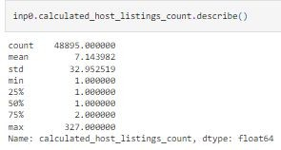
6.11 calculated_host_listings_count

Slide 29
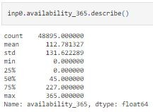
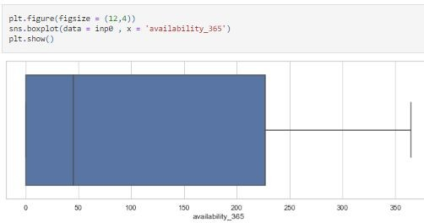
6.12 availability_365

Slide 30
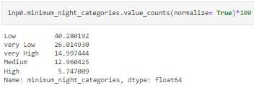
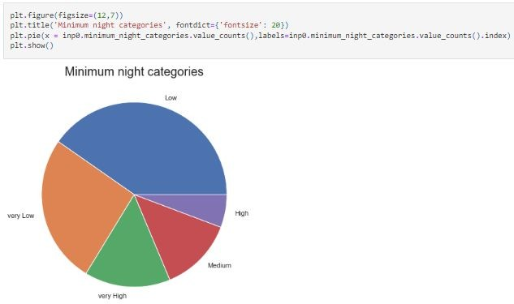
6.13 minimum_night_categories

Slide 31
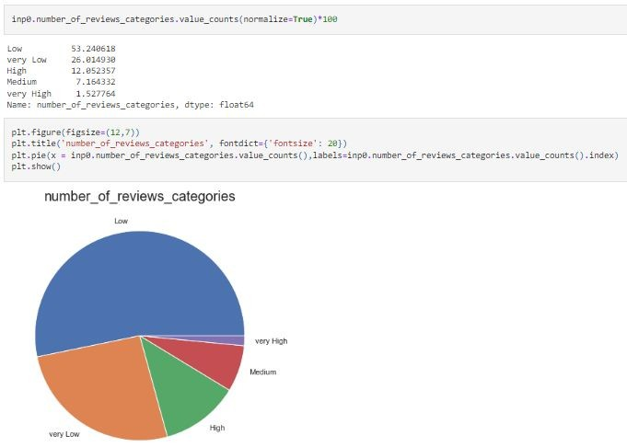
6.14 number_of_reviews_categories

Slide 32
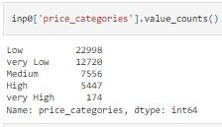
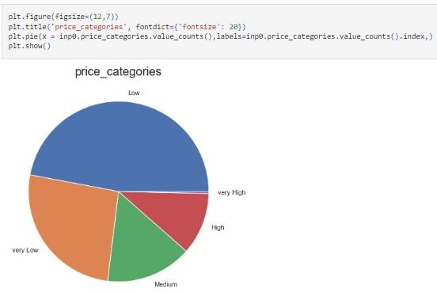
6.15 price_categories
What is the pricing ranges preferred by customers?
'Low' price ranges are preferred by customers followed by very 'Low' price ranges.

Slide 33
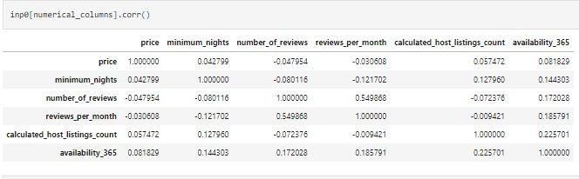
Bivariate and Multivariate Analysis
Finding the correlations

Slide 34
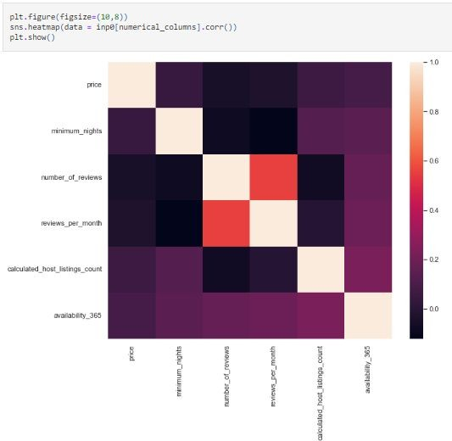

Slide 35
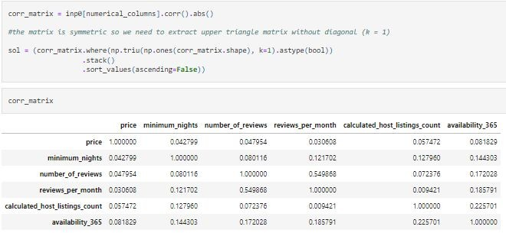
7.2 Finding Top correlations

Slide 36
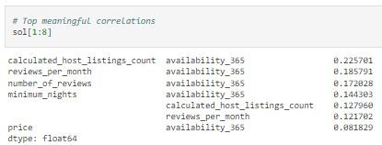

Slide 37
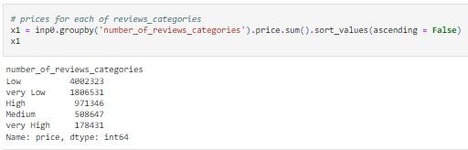
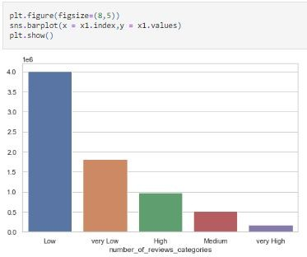
7.3 number_of_reviews_categories and prices
What is the pricing ranges preferred by customers?
The total price for 'Low' or 'very Low' number_of_reviews_categories are high.

Slide 38
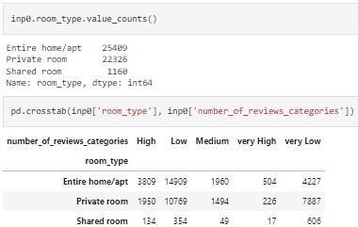
.4 ('room_type' and 'number_of_reviews_categories')
The various kinds of properties that exist w.r.t. customer preferences.?
Entire home/apt have more reviews than Shared rooms 'Shared room' are less likely to give reviews. only 16 %

Slide 39
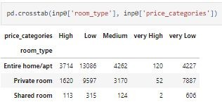
7.5 'room_type' and 'price_categories'

Slide 40

7.6 'room_type' and 'reviews_per_month'
For each 'room_type' there are ~1.4 reviews per month on average.

Slide 41

7.7 minimum_night_categories and reviews_per_month
Customers are more likely to leave reviews for low number of minimum nights
Adjustments in the existing properties to make it more customer-oriented. ?
minimum_nights should be on the lower side to make properties more customer-oriented

Slide 42


7.8 'availability_365_categories', 'price_categories' and 'reviews_per_month'
If the combination of availability and price is very high, reviews_per_month will be low on average.
Very high availability and very low price are likely to get more reviews.

